Slide 1


CAR: PRICE PREDICTION
SUBMITTED BY: DILIP KUMAR

Slide 2
CONTENTS
Introduction
Overview
Let’s start the Data-Analysis.
Exploratory Data Analysis
Data Pre-Processing
Observations
Conclusion

Slide 3
Introduction
Determining whether the listed price of a used car is a challenging task, due to the many factors that drive a used vehicle’s price on the market. The focus of this project is developing machine learning models that can accurately predict the price of a used car based on its features, in order to make informed purchases. We implement and evaluate various learning methods on a dataset consisting of the sale prices of different makes and models .
Regression Algorithms are used because they provide us with continuous value as an output and not a categorized value because of which it will be possible to predict the actual price a car rather than the price range of a car. User Interface has also been developed which acquires input from any user and displays the Price of a car according to user’s inputs.
Let’s start the Data-Analysis.

Slide 4
Overview
The price of a new car in the industry is fixed by the manufacturer with some additional costs incurred by the Government in the form of taxes. So, customers buying a new car can be assured of the money they invest to be worthy. But,
due to the increased prices of new cars and the financial incapability of the customers to buy them, . Existing System includes a process where a seller decides a price randomly and buyer has no idea about the car and it’s value in the present day scenario. In fact, seller also has no idea about the car’s existing value or the price he should be selling the car at. To overcome this problem we have developed a model which will be highly effective. Regression Algorithms are used because they provide us with continuous value as an output and not a categorized value. Because of which it will be possible to predict the actual price a car rather than the price range of a car.
Let’s start the Data-Analysis.

Slide 5
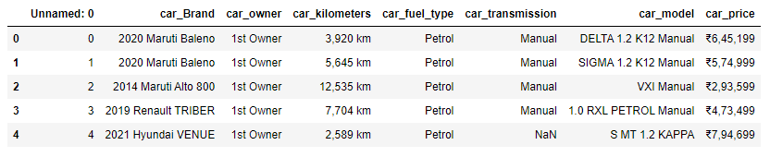
Dataset overview
• Number of data points in train data:2799.
• Number of features in train data: 7.
• Data contains numerical as well as categorical variable.
• With 7 explanatory variables describing (almost) every aspect of used car price in Ames, Iowa, this competition challenges you to predict the final price of each car
Let’s start the Data-Analysis.

Slide 6
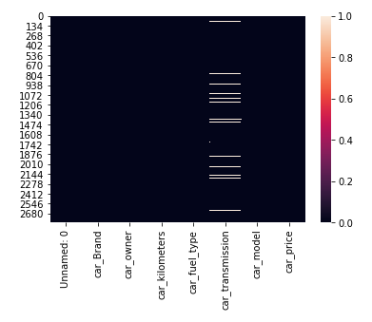
The Null values present in dataset
Let’s start the Data-Analysis.

Slide 7
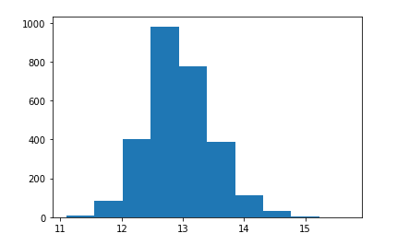
Distribution of car prices
Let’s start the Data-Analysis.

Slide 8
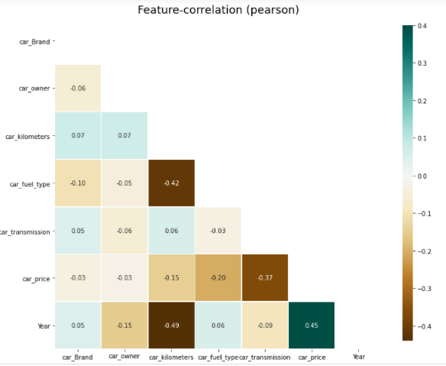
Correlations
Let’s start the Data-Analysis.

Slide 9
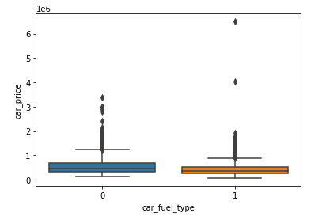
Relationship between fuel type and car Price
Let’s start the Data-Analysis.

Slide 10
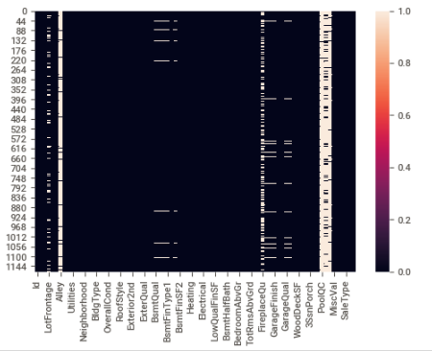
Missing Values
Let’s start the Data-Analysis.

Slide 11
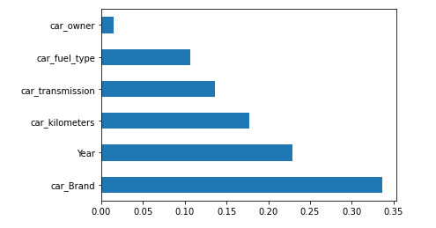
Top Five Feature
Let’s start the Data-Analysis.

Slide 12
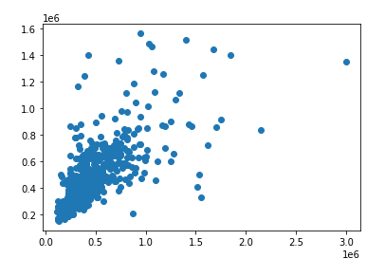
Scatter plot between predicated and actual value
Let’s start the Data-Analysis.

Slide 13
Observations :
1. The first paper is Predicting the price of Used Car Using Machine Learning Techniques.In this paper, they investigate the application of supervised machine learning techniques to predict the price of used cars in Mauritius. The predictionsare based on historical data collected from daily newspapers. Different techniques like multiple linear regression analysis, k-nearest neighbours, naïve bayes and decision trees have been used to make the predictions.
The Second paper is Car Price Prediction Using Machine Learning Techniques. Considerable number of distinct
attributes are examined for the reliable and accurate prediction. To build a model for predicting the price of used
cars in Bosnia and Herzegovina, they have applied three machine learning techniques (Artificial Neural Network,
Support Vector Machine and Random Forest).
The Third paper is Price Evaluation model in second hand car system based on BP neural networks. In this paper, the
price evaluation model based on big data analysis is proposed, which takes advantage of widely circulated vehicle
data and a large number of vehicle transaction data to analyze the price data for each type of vehicles by using the
optimized BP neural network algorithm. It aims to establish a second-hand car price evaluation model to get the price
that best matches the car.
Enter title here
Click here to add content of the text，and brifly explain your point of view
Enter title here
Click here to add content of the text，and briefly explain your point of view

Slide 14
Conclusion
In future this machine learning model may bind with various
website which can provide real time data for price prediction. Also we may add large historical data of car price which can help to improve accuracy of the machine learning model. For better performance, we plan to judiciously design deep learning network structures, use adaptive learning rates and train on clusters of data rather than the whole dataset.
The increased prices of new cars and the financial incapability of the customers to buy them, Used Car sales are on a global increase. Therefore, there is an urgent need for a Used Car Price Prediction system which effectively determines the worthiness of the car using a variety of features. The proposed system will help to determine the accurate price of used car price prediction. This paper compares 3 different algorithms for machine learning : Linear Regression, Lasso Regression and Ridge Regression.
Let’s start the Data-Analysis.

Slide 15
THANK YOU
SUBMITTED BY: DILIP KUMAR

